Slide 1
Encoders and Decoders
Presentation on

Slide 2
Encoders
Encoders is the combinational circuits that change the binary information into N output lines.
Encoder performs the reverse operation of the decoder.
An encoder has a number of input lines , only one of which is activated at a time.
It has 2^{n} inputs.
It has n outputs.

Slide 3
Types of encoders
Decimal to BCD encoder
Octal to binary encoder
Priority encoder
Hex to binary encoder

Slide 4
Design 4 to 2 line Encoder
Inputs: There are total of four inputs i.e. I₃,I₂,I₁,I₀
Output: There are two outputs A₁,A₀
Block Diagram :
I₀
I1 A0
I₂
I3 A1

Slide 5
Truth table
Inputs |  |  |  | outputs
I₃ | I₂ | I₁ | I₀ | A₁ | A₀
0 | 0 | 0 | 1 | 0 | 0
0 | 0 | 1 | 0 | 0 | 1
0 | 1 | 0 | 0 | 1 | 0
1 | 0 | 0 | 0 | 1 | 1

Slide 6
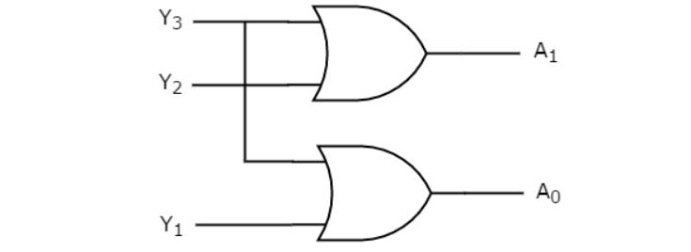
Logical expression
A₁=I₃+I₂
A₀=I₃+I₁
Logical expression

Slide 7
Design 8*3 Encoder
The 8*3 encoder is also known as octal to binary encoder.
In 8*3 line encoder:
8 inputs
3 outputs

Slide 8
Block Diagram
I₇
I₆
I₅ A₂
I₄
I₃ A₁
I₂
I₁ A₀
I₀

Slide 9
Truth table
Inputs |  |  |  |  |  |  |  | Outputs
I₇ | I₆ | I₅ | I₄ | I₃ | I₂ | I₁ | I₀ | A₂ | A₁ | A₀
0 | 0 | 0 | 0 | 0 | 0 | 0 | 1 | 0 | 0 | 0
0 | 0 | 0 | 0 | 0 | 0 | 1 | 0 | 0 | 0 | 1
0 | 0 | 0 | 0 | 0 | 1 | 0 | 0 | 0 | 1 | 0
0 | 0 | 0 | 0 | 1 | 0 | 0 | 0 | 0 | 1 | 1
0 | 0 | 0 | 1 | 0 | 0 | 0 | 0 | 1 | 0 | 0
0 | 0 | 1 | 0 | 0 | 0 | 0 | 0 | 1 | 0 | 1
0 | 1 | 0 | 0 | 0 | 0 | 0 | 0 | 1 | 1 | 0
1 | 0 | 0 | 0 | 0 | 0 | 0 | 0 | 1 | 1 | 1

Slide 10
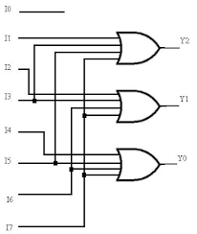
Logical expression
A₂=I₄+I₅+I₆+I₇
A₁=I₂+I₃+I₆+I₇
A₀=I₇+I₅+I₃+I₁
Logical Diagram

Slide 11
Design decimal into BCD encoder(10:4)
The decimal to binary encoder usually consists of 10 input lines and 4 output.
Inputs= there are ten inputs.
Outputs=four outputs.
Block Diagram
8
Inputs outputs
Decimal to binary encoder

Slide 12
Truth table
Inputs |  |  |  |  |  |  |  |  |  | Outputs
I9 | I8 | I7 | I6 | I5 | I4 | I3 | I2 | I1 | I0 | A3 | A2 | A1 | A0
0 | 0 | 0 | 0 | 0 | 0 | 0 | 0 | 0 | 1 | 0 | 0 | 0 | 0
0 | 0 | 0 | 0 | 0 | 0 | 0 | 0 | 1 | 0 | 0 | 0 | 0 | 1
0 | 0 | 0 | 0 | 0 | 0 | 0 | 1 | 0 | 0 | 0 | 0 | 1 | 0
0 | 0 | 0 | 0 | 0 | 0 | 1 | 0 | 0 | 0 | 0 | 0 | 1 | 1
0 | 0 | 0 | 0 | 0 | 1 | 0 | 0 | 0 | 0 | 0 | 1 | 0 | 0
0 | 0 | 0 | 0 | 1 | 0 | 0 | 0 | 0 | 0 | 0 | 1 | 0 | 1
0 | 0 | 0 | 1 | 0 | 0 | 0 | 0 | 0 | 0 | 0 | 1 | 1 | 0
0 | 0 | 1 | 0 | 0 | 0 | 0 | 0 | 0 | 0 | 0 | 1 | 1 | 1
0 | 1 | 0 | 0 | 0 | 0 | 0 | 0 | 0 | 0 | 1 | 0 | 0 | 0
1 | 0 | 0 | 0 | 0 | 0 | 0 | 0 | 0 | 0 | 1 | 0 | 0 | 1

Slide 13
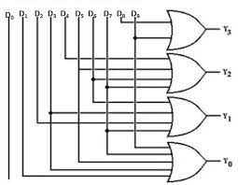
Logical Diagram

Slide 14
Priority Encoder 4 into 2 line priority encoder
In this priority encoder there are four inputs and two outputs A0 and A1
The I3 has high and I0 has low priority.
Block Diagram
Inputs Outputs
Priority
Encoder

Slide 15
Truth table
inputs |  |  |  | Outputs
I3 | I2 | I1 | I0 | A1 | A0 | V
0 | 0 | 0 | 0 | * | * | 0
0 | 0 | 0 | 1 | 0 | 0 | 1
0 | 0 | 1 | * | 0 | 1 | 1
0 | 1 | * | * | 1 | 0 | 1
1 | * | * | * | 1 | 1 | 1

Slide 16
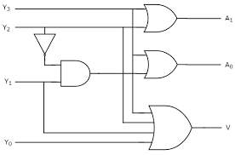
Logical Expression
A1=I3+I2
A0=I3+I2’I1
Logical diagrams

Slide 17
Decoder
It is combinational circuits, it change the binary information into 2^{n} lines is known as decoders.
In decoders:
N inputs
2n outputs
Decoder enable input signal
Decoder performs the reverse operation of the encoder.

Slide 18
Block Diagram
N Inputs 2^{n}outputs
N to 2^{n} decoders

Slide 19
Design 2 into 4 line in Decoder
2 into 4 Decoder will consists of the following:
2 inputs
2² =4 outputs
1 Enable input signal(E)
Block Diagram
Inputs Outputs
2 into 4 Decoder

Slide 20
Truth Table
Enable | Inputs |  | Outputs
E | A | B | X0 | X1 | X2 | X3
1 | 0 | 0 | 1 | 0 | 0 | 0
1 | 0 | 1 | 0 | 1 | 0 | 0
1 | 1 | 0 | 0 | 0 | 1 | 0
1 | 1 | 1 | 0 | 0 | 0 | 1
Logical expression
X0=EA’B’ X1=EA’B
X2=EAB’ X3=EAB

Slide 21
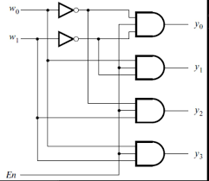
Logical Diagram

Slide 22
3 into 8 decoder
3 Inputs
2³=8 Inputs
1 Enable Input Signal
Block Diagram:
Inputs Outputs
3 into 8 Decoder

Slide 23
Truth Table
Enable | Inputs |  |  | Outputs
E | A | B | C | X0 | X1 | X2 | X3 | X4 | X5 | X6 | X7
0 | d | d | d | 0 | 0 | 0 | 0 | 0 | 0 | 0 | 0
1 | 0 | 0 | 0 | 1 | 0 | 0 | 0 | 0 | 0 | 0 | 0
1 | 0 | 0 | 1 | 0 | 1 | 0 | 0 | 0 | 0 | 0 | 0
1 | 0 | 1 | 0 | 0 | 0 | 1 | 0 | 0 | 0 | 0 | 0
1 | 0 | 1 | 1 | 0 | 0 | 0 | 1 | 0 | 0 | 0 | 0
1 | 1 | 0 | 0 | 0 | 0 | 0 | 0 | 1 | 0 | 0 | 0
1 | 1 | 0 | 1 | 0 | 0 | 0 | 0 | 0 | 1 | 0 | 0
1 | 1 | 1 | 0 | 0 | 0 | 0 | 0 | 0 | 0 | 1 | 0
1 | 1 | 1 | 1 | 0 | 0 | 0 | 0 | 0 | 0 | 0 | 1

Slide 24
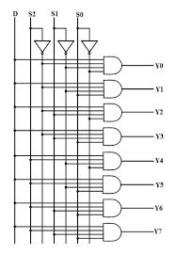
Logical Expression
X0=A’B’C’ X1=A’B’C
X2=A’BC’ X3=A’BC
X4=AB’C’ X5=AB’C
X6=ABC’ X7=ABC
Logical Diagram

Slide 25
Download ppt’s and handwritten notes
JP Web devolpers
Follow on instagram:-@jpwebdevelopers
Thank
you

